Slide 1
Digital Acceleration
Powered by Apigee
Notes:
There is a lot of excitement about the potential of digital platforms.
Deservedly so, if you consider some of what we’ve heard already here today, and what we have on deck for the rest of the day.
But if you are part of an established business—one that has been around for a hundred years or more, or even 50, the vast majority of that time before “digital” as we now know it was even imagined—you might have mixed feelings about what it means to you.
There’s just as much excitement—or fear—around “digital disruption.”
I don’t have mixed feelings – I firmly believe 100 year old companies have an incredible opportunity.
In fact what I hope to convey to you today is a vision and an action plan beyond table stakes—not what you need to participate if you are a hundred year old company, but how you can lead. Because I know of some 100-year old companies—some of whom we will talk about this morning—who are poised to do just that.
But unlocking the opportunity is not without challenges.

Slide 2
Technologies have
changed the market context
This has
happened before
Mainframe
Client Server
Web, SOA
IoT, APIs
1960’s, 70’s
1970’s, 80’s
1990’s
2010’s
Those who fail to adapt to change
Those who adopt the technology
Those who (re)build their business around the change
Notes:
Technology has changed the market context—in this case, led by mobile, powered by cloud, and exploding into billions of smart, sensing devices…
CLICK
But this has happened before. Other waves of technology have changed the market landscape, business and society.
CLICK
13
But this has happened before. Other waves of technology have changed the market landscape, business and society.
14
And when these big technology-driven changes happen, there are three kinds of companies:
CLICK
those who simply fail to adapt…these are the companies that vanish, or at least struggle as a shadow of their former selves. These are the buggy-whip makers who passed on the whole automobile thing…
CLICK
then there are those who adopt the relevant technology or technologies…these companies stay competitive, endure, even continue growing
CLICK
but the ones who change the game and become market shapers themselves—they do more than just become competent with technology. They build—or rebuild—their business around the change, so the change becomes a driver of growth for them.
One of the key indicators that a company is on this path is whether their success would be outlandish, even impossible, to achieve in the previous market context, before the new technology started having a massive impact….
You can probably guess the mobile example….

Slide 3










Business Drivers
Web
Tablets
Smart phones
Kiosks
Store PoS
API
Digital assets
API
API
Partner integration
API
Connected cars
Connected fitting rooms
Smart sensors
IoT
Gaming consoles
Notes:
Explosion of the number of devices that need to be interconnected
Started with smartphones, tablets --- apps for a companies’ consumers or employees as people started to stare into their devices 24x7
Also started with desires for companies to expose data and information to more and more partners outside their firewall, and to do so securely
increasingly find ourselves in conversations about CFR, cars, kiosks and of course IoT
Existing SOA based systems cannot enable companies to adapt to this inflexion

Slide 4






Connected Experience
Connected Experience
Days
Intelligent API Platform
Pace of change
Security
Mediation
Traffic Management
Analytics
ESB / Integration
CRM
ERP
Database
Data Warehouse
Data Lake
Years
System of Record
Analytics
Notes:
So What are companies doing in practice to unlock the digital platform opportunity
Implementing systems of engagement
You’ll recognize this as Two speed or bimodal IT –
That’s table stakes for IT to be able to operate at the speed of today’s consumer
However
The secret is that
TWO SPEED IT DOES NOT MAKE YOUR BUSINESS A PLATFORM
WHAT MAKES YOU A PLATFORM IS THE DATA
All of the companies we mentioned above that are remaking their businesses for digital are doing this
Using apis
Enabling the flow of data
Make possible to build developer ecosystems

Slide 5
Existing Infrastructure was Built for the System of Record
Scales to millions of users
Application
Mobile/Cloud is an add-on
Centralized security
App Server
Limited use to data
IT Ops
Database
EAI enterprise application integration
ETL
extraction transform
loading
Developer
Tools
Operating System
Centralized innovation

Slide 6
Requirements for the System of Engagement
Yesterday
Future
Scales to millions of users
Scale to billions of users
Mobile/Cloud first
Mobile/Cloud is an add-on
Security @ points of engagement
Centralized security
End-to-end visibility across digital value chain
Limited use to data
DevOps
IT Ops
Distributed innovation
Centralized innovation

Slide 7


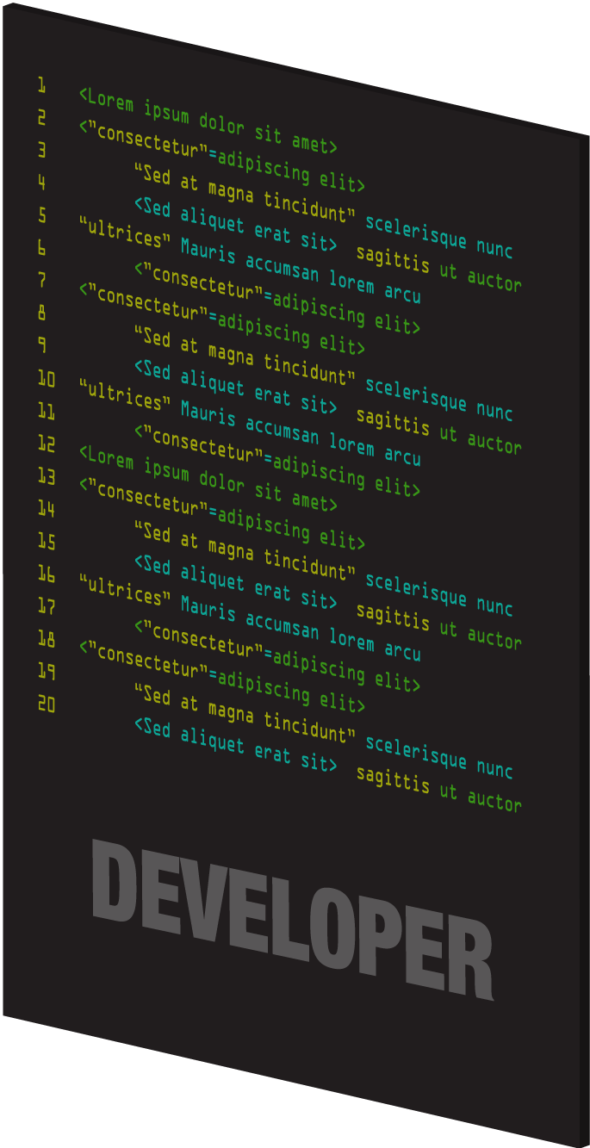







Digital value chain
Notes:
Main Point
Any solution must address the full digital value chain
Script
These aren’t the kind of things that you can accomplish as an afterthought with some bolt-on solution. Only a platform that extends across the digital value chain will offer the necessary capabilities.
Let me explain. Between the end user and the business’s back-end systems lie several important participants and pieces of technology, all of which need to work together seamlessly.
Any and all apps, the developers who build them, the API they use, the API team—all of these things have requirements that can only be addressed by an integrated platform.

Slide 8












Reporting and monitoring
Monetization
Security
Predictive analytics
Global deployment
Onboarding
API documentation
APIs and data
The right foundation avoids pain
Developer
authentication
Transformation
Traffic management
Mobile optimization
Partner customization
Data
Versioning
Notes:
Main Point
Digital is a big change and requires the right foundation
Script
It may not look that hard from the outside; after all, developing a single app seems simple. But it never stays that way.
Most IT departments don’t have the tools or experience to ensure that an app can scale or keep up with evolving needs and capabilities. And what happens when one app turns into two, or ten, or a hundred? Or your business decides to integrate smart sensors or wearable devices?
Even if you only have one planned API use case today, you need to build for the way it will be used and managed tomorrow. That means addressing a whole host of challenges including security, transformation, traffic management, mobile optimization, partner customization, versioning, onboarding, developer authentication, API documentation, reporting and monitoring, monetization, and global deployment.
Each one is complicated on its own; put them together and it’s a lot more than your traditional IT tools were built to manage. If you’re going to solve all of them, you need a platform that was built to do just that.
The solution is a purpose-built platform, designed from the ground up for digital business.

Slide 9
To Specifically Solve These Problems
IT
How can I quickly respond to the demands of marketing while maintaining control and security?
Business How can I dramatically expand the number of mobile and web apps to my consumers and employees, as well as through my partners?
“So, let me get this straight. Apigee is the glue that binds IT and Marketing together, right?”
- CTO, Top Digital Agency

Slide 10









































Major Customers in All Major Verticals
Service Providers
Financials
Retail
Media and Entertainment
Technology
Life Sciences
Healthcare
Notes:
And with all of these customers across verticals, we still have lots of room to expand together: Walgreens, Disney, Target, McKesson
Hardly scratched the surface – our relationship has the potential to deliver $100s of millions
Strongest segments are retail, CG&S, and life sciences. Hospitality = Hilton and Marriott --- automotive too – GM is a customer
Hope that explains the why – we’re partnering to do business together, to do it well, and with market motions already established and tested.
NOW LETS TALK ABOUT THE WHAT

Slide 11

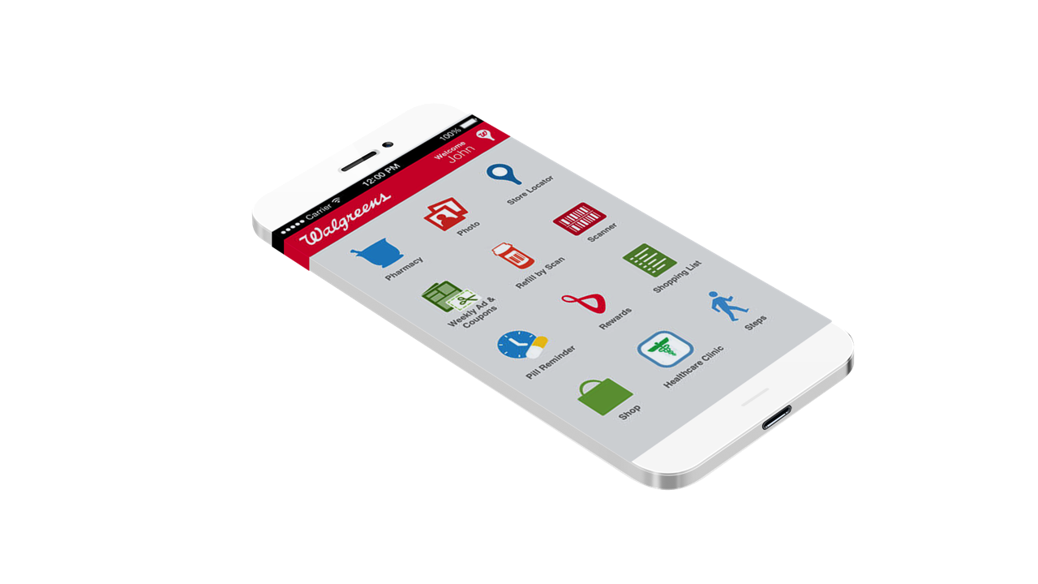



Walgreens
More than one refill per second via mobile devices
Digital loyalty program: 83M members in 12 months
Connect fitness app or device to loyalty account
6x sales increase versus store only
Over 75 partner apps using QuickPrint APIs
Platform for telehealth
Notes:
Walgreens is a hundred years old. And they are have adopted new technology. This is good:
But this is great:
http://news.walgreens.com/press-releases/general-news/walgreens-and-mdlive-expand-telehealth-platform-to-three-new-states-add-desktop-and-tablet-functionality.htm
Walgreens talks explicitly about “putting an API around our stores”. They are turning their value chain into a digital platform driving sales at their stores
More than one refill per second via mobile devices
Over 75 partner apps using QuickPrint APIs
6x sales increase vs. store only
Summary:
Walgreens, the largest US drugstore chain, wanted to take advantage of the growth in pictures taken from Smartphones. Using Apigee they built an open API, QuickPrints which has been enthusiastically received by developers and is expected to increase Walgreens printing business by 20%.
Opportunities and Challenges
Largest US drugstore chain
Wanted to take advantage of the growth in pictures taken from Smartphones
Walgreens App with QuickPrint capability not wildly successful
Needed 3rd party API to leverage external innovation
Solution
Apigee Edge digital business platform
On-Premises Deployment
Open API for QuickPrints – Print to Walgreens option
Results
Customers who shop across all three channels – store, mobile and web – actually spend an average of six times as much as store-only customers
Built in 9 months a loyalty program of 72 million people
Leveraging external innovation for reach, and revenue
Used by developer of Kicksend, and Pic Stitch
Able to implement API in an App couple of hours
‘Best Mobile App for Retail” in South by Southwest Appy Awards
Their Words
“The goal is to drive customer interactions. It doesn't matter where it starts from because it's all flowing into your business”
- Joe Rago Senior Product Manager Walgreens Mobile
Background Info
With the Apigee platform in place, any brand can uncover hidden digital value and grow their business—even a brand like Walgreens, that might have struggled with transitioning to the digital world.
Take the example of photo printing. No one turns in strips of film anymore; everyone takes photos on their smartphones, or using digital cameras. So what can Walgreens do with all their massive photo printing equipment? Using their API, they were able to develop an app that lets customers print photos directly from their devices to the stores. The QuickPrints capability was so popular that it was adopted by partner apps that gave the developer 15% revenue share of the print sale.
And it’s not just photos. Today, there are over 75 partner apps that use the Walgreens APIs. Walgreens gets more than one prescription refill every second through mobile apps. They’re using their balance rewards API to drive in-store engagement. The combination of in-store, online, and mobile capabilities have increased average customer spend by 6x compared to those who shop solely in-store. And while they were building this digital business they added 74million customers to their balance rewards program in just 9 months.
Walgreens Opens API for Mobile Prescription Scanning to Developers
By Brian T. Horowitz | Posted 2013-02-13
Walgreens has announced a new application program interface that allows third-party developers to incorporate the ability to scan barcodes from prescription bottles.
The API will allow consumers to use third-party apps to renew prescriptions at the pharmacy chain's more than 8,000 locations.
"People continue to become increasingly engaged with their mobile devices and use the technology to help make their day-to-day lives easier," Abhi Dhar, e-commerce chief technology officer at Walgreens, said in a statement. "By incorporating the Walgreens Prescription API, mobile app developers are providing users with an easy way to refill prescriptions and help them properly take their medication."
Walgreens offers a similar API for in-store photo services called QuickPrints SDK and API, allowing developers to incorporate the ability to print photos from a mobile app in the pharmacy chain's stores.
A $4.99 mobile personal health app for the iPad called Healthspek now incorporates the Walgreens API and allows users to refill prescriptions. The $1.99 iOS app PocketPharmacist for the iPhone and iPad also enables medicine-bottle scanning using the API, which Walgreens announced on Feb. 4.
Before offering the API, Walgreens had integrated a Refill by Scan feature in its own app, available for iOS, Android and BlackBerry. Users receive a text message from Walgreens when their medications are ready for pickup.
More than 40 percent of Walgreens' online refill requests originate from the chain's mobile app, according to MobiHealthNews.
The Walgreens native app allows users to find retail locations, set medication reminders, research information on medications, order photos and make appointments at its in-store Take Care Health System clinics, where board-certified nurse practitioners are available to provide exams.
A CVS Pharmacy app for iOS and Android offers similar medication-scanning capabilities. The app allows users to scan prescription barcodes using a smartphone's camera. It also provides the ability to identify pills by imprint, shape or colors.
Third-party developers can register for a user account on the Walgreens Developer Portal to access the API. They then receive an API key to access the service.
The goal of incorporating the Refill by Scan feature into mobile applications is to increase medication compliance and boost personal health management, Walgreens reported.
By opening its Refill by Scan feature to third-party developers, Walgreens is looking to tap the "creativity of the developer community," Dhar told MobiHealthNews.
Walgreens is offering the API for iOS version 3.2 and higher, Android version 2.3 and higher, Windows Phone 7 and 7.5, and BlackBerry version 6.0 and higher. The pharmacy chain built the checkout pages for the API using jQuery Mobile, an HTML5-based user interface system for mobile device platforms.
Barcode scanning is a growing trend in health care as the industry looks to scan records from paper into digital form.
In addition to consumer prescription refills, hospitals use similar barcode-scanning technology to track medication vials throughout a hospital workflow. Health care organizations are using barcoding technology to link patient data with electronic health records and keep track of surgical equipment. Companies that offer data-capture technology include Hewlett-Packard, Intermec, Lexmark and Zebra Technologies.
Begin forwarded message:
From: Chuck Dunham <cdunham@apigee.com>
Subject: New customer update: Walgreens Advanced Analytics Services
Date: December 6, 2013 1:05:47 PM EST
To: all <all@apigee.com>
We have just finalized a new three year agreement for Advanced Analytics Services (formerly Mobile Analytics) with Walgreens.
Customer:
The Walgreen Company is the largest drug retailing chain in the United States. Walgreens provides access to consumer goods and services, plus pharmacy, health and wellness services in the United States through its retail drugstores, Walgreens Health Services division, and Walgreens Health and Wellness division. Walgreens has over 8,000 drugstores and runs several online stores, such as Beauty.com, Drugstore.com and VisionDirect.com. Walgreens is a great example of a company that has driven more store traffic and sales by creating API’s and opening them up to developers (both internal and external) to create a number of Apps.
Use case:
Walgreens is an existing, highly visible reference customer of Apigee and a poster child for API’s driving digital transformation. They are a customer who recognized that Apigee can deliver beyond API’s and can deliver value all the way to the App itself. This deal is for two different groups within Walgreens – the Mobile team and the Operations Center. While Walgreens has a number of analytical tools for backend systems and their .com properties, they realized they didn’t have much in the way of tools or processes for analyzing the performance of the mobile apps. As mobile has become more strategic to Walgreens’ business it became clear they realized this is a big gap and embarked on a search for a solution that enabled them to track, measure and analyze their mobile apps to ensure good performance and maintain high star ratings in the app stores.
Why Apigee:
As we often find more and more these days, by the time we engaged the customer, the mobile team had already determined their mobile performance monitoring requirements and had researched several mobile APM vendors. Walgreens wouldn’t tell us who we were competing against but we knew we had some key differentiators and an existing relationship that we could leverage. We were able to show how only Apigee could give end-to-end visibility and monitoring from the apps on the mobile device through the API’s to the backend systems. We got their technical resource (the Bear) started with Apigee Developer and Prabhat Jha and Paul Dardeau from Engineering help enabled him to port one of their apps into Advanced Analytics Services in a single afternoon. The fact that Apigee is a known commodity with a history of success within Walgreens combined with the positive relationship we had with the API team helped us to be quickly selected.
Team:
Many thanks to the Apigee team: SE - Carlos Eberhardt, Product Management – Alan Ho and Kumar Srivastava, Product Marketing – Abhi Rele, Engineering – Mike Gardner, Prabhat Jha, Paul Dardeau, Legal- Mark Silvern
chuck dunham | apigee | o: +1.440.237.0188 | m: +1.443.745.1263 | Skype: chuck.dunham.3152
=============
Apps that integrate Walgreens QuickPrints API which runs on Apigee.
iPhone Apps: Pinweel, GroupShot, Kicksend, Pic Stitch, Photo Collage Creator, StillShot, Filterastic+, Whot! Shot, Printicular, CameraXE, Rage Camera Pro, Free Captions, HP ePrint service, Caption & Share, Versaries, Cardmento, Part, Photo Editor by Aviary, Flickring, Canvas Print by Printicular, FratSnapz, JustFamily, Dscvry, LifePics, My Photo Sizer, CapsuleCam, Web Albums, Fanmento!, CollageCam, StampsCam
Android Apps: Kicksend, Printicular, Canvas Print by Printicular, Pictarine, PicDrop, Photo Print, LifePics
iPad Apps: GroupShot, Pic Stitch, Photo Collage Creator, Filterastic+, Printicular, Rage Camera Pro, Part, Photo Editor by Aviary, Canvas Print by Printicular, LifePics, My Photo Sizer, Web Albums HD, Flickring HD
Windows 8 PC & Tablet Apps: Kicksend, Pic Stitch, Printicular, Order Prints by Peridot Technologies
Windows 8 Phone Apps: Pic Stitch, LifePics
BlackBerry 10 Apps: Printicular
Web Apps: Kicksend.com, LifePics.com, Photobucket.com, AnyCloud.com
Mobile Web Apps: HappiZap.com
-----
How Walgreens leveraged mobile, digital to build 72M member loyalty program
Posted By Lauren Johnson On June 27, 2013 @ 5:00 am In Database/CRM,Drugstores and pharmacies,Featured | No Comments
[1]NEW YORK – A Walgreens executive at Forrester’s Forum For Customer Experience Professionals East said that the retailer has acquired 72 million loyalty members in the past nine months by focusing on mobile and digital as key components to an omnichannel approach.
During the “Walgreens: At The Corner Of Experience And Innovation” session, the executive spoke about the ways that the company is embracing an omnichannel tactics to bridge retail, pharmacy and wellness services. Additionally, the exec revealed some findings on the company’s digital and mobile traffic.
“We launched this program last year with a very clear and intense view about this being an omnichannel product that was designed to show off, showcase and tee-off our assets right across the enterprise,” said Graham Atkinson, senior vice president and chief marketing and customer experience officer at Walgreens, Deerfield, IL.
“From the get-go, we wanted this to be omnichannel, we wanted people to be able to sign-up very easily either in-store, which takes about 30 seconds, or online at home or indeed from people’s mobile devices,” he said. “Over nine months, [there are] over 70 million people and not a single piece of paper.”
Secret sauce to loyalty
Walgreens [2]launched its
loyalty program nine months ago with an omnichannel focus.
The program allows consumers to earn points across the company’s suite of assets from in-store, online or from a mobile device.
Additionally, Walgreens has built some aspects that incorporate health into the program as a way to both acquire and retain loyalty program members.
For example, Walgreens ran a program called Steps that encouraged consumers to get and stay fit. Steps was integrated into the Rewards loyalty program so that app users could connect their walking and running activity to their rewards as well as exchange ideas with the brand’s program.
For every prescription that Rewards program users make, they receive points. The idea here is to pull Walgreens’ DNA into the program that incentives people to get and remain healthy.
The third element in the program’s success is a chat function that lets consumers contact a Walgreens pharmacist 24/7 with any questions on their medication or general health. This feature will soon be rolled out to the company’s app, per Mr. Atkinson.
Digital health care
Walgreens has roughly two million daily digital visits with nine Web sites and ten mobile applications.
Interestingly, half of Walgreens’ traffic from smartphones and tablets occurs when consumers are in-store, which points to the need to hook up multiple interactions that consumers have into one experience.
Mr. Atkinson said that consumers think about Walgreens as an entity, not as a channel.
Essentially, retailers need to think holistically about the customer’s journey to be successful nowadays.
Additionally, simplifying the channels and being able to measure across different mediums is critical.
The smartphone forces Walgreens to think about limited real estate. When marketers decide to push one more thing into an ad, it leads to consumers thinking that the experience is too complicated.
For example, Walgreens has a service called transfer by scan built into its mobile app. Consumers can change a repeat prescription to a different pharmacy through taking a picture of the pill bottle and emailing it to the company. This is a process that traditionally requires eight to ten steps.
“Whether it is home delivery, whether it’s in-store, whether it’s comparison pricing, whether it’s showrooming at home and then going in-store – which is somewhat counter-intuitive to the common retail focus– we see this as something that is very much about understanding the touch points that the company goes through,” Mr. Atkinson said.
Final Take
Lauren Johnson is associate reporter on Mobile Commerce Daily, New York
Article printed from Mobile Commerce Daily: http://www.mobilecommercedaily.com
URL to article: http://www.mobilecommercedaily.com/how-walgreens-leveraged-mobile-digital-to-build-72m-member-loyalty-program
-----------------
From news article:
As of this morning all of Walgreens mobile APIs like store locater, and prescription refill are now routing through our Apigee gateways. These mobile services are called from a range of devices including android, iPhone and iPad.
This release is first step for Walgreens as they modernize their existing service offerings along with building new services. This process of modernization is making use of our infrastructure to ease the transition from servlet based communication to a restful APIs, along with making use of Apigee as a tool to help developers make great use of the Walgreens APIs.
Walgreen is expected to announce Tuesday that it is teaming up with independent mobile app developers to allow consumers to print snapshots from third-party photo sharing services at their neighborhood Walgreen store. This builds on a service the drugstore chain has offered since March in which iPhone and Android users can make prints right from their phones in-store.
Innovator Spotlight: Walgreens
The goal is to drive customer interactions. It doesn't matter where it starts from because it's all flowing into your business
Joe Rago Senior Product Manager Walgreens Mobile
Walgreens is the largest drugstore chain in the United States, operating more than 7,900 drugstores across the country. Each day, Walgreens provides nearly 6 million customers with convenient, multichannel access to consumer goods and services and trusted, cost-effective pharmacy, health and wellness services and advice. In July, 2012, Walgreens built on its tradition of technology innovation with the introduction of its first open API, QuickPrints.
We spoke to Joe Rago, senior product manager for Walgreens Mobile, about Walgreens' foray into open APIs with QuickPrints and their vision to "put an API around our stores."
Why did Walgreens adopt an API strategy?
At the highest level, we've always been focused on giving our customers the ability to interact with Walgreens through a number of different channels, and this has evolved over time. The company launched Walgreens.com in the mid-1990s to expand its reach and followed that up with a mobile website in 2007. Then in 2009, we offered our first native application on the iPhone platform with other native apps that followed for Android (phone), BlackBerry, Windows Phone, iPad and Kindle Fire. Delivering an open API to foster a broad array of third-party apps that leverage Walgreens services was a natural next step.
The need for the QuickPrints API specifically came to me when I was on my iPhone, looking in the camera roll and the only option was to tie into a printer – which many people don’t have immediate access to. To print photos, you need the right kind of printer, paper and ink – not everyone has this. We knew that printing to Walgreens from a mobile device would be easy for people and would give them quality prints.
What APIs does Walgreens offer today?
Our first open API is for QuickPrints, a Walgreens service that enables photo printing directly from iPhone, iPad and Android mobile devices. Quick Prints lets mobile users print 4x6, 5x7 or 8x10 photos directly from their phone and pick them up at Walgreens 7900+ stores nationwide in about an hour. Today, developers are able to add the “print to Walgreens” function in their apps using the QuickPrints SDK.
Who are the primary users of your APIs?
The QuickPrints SDK has always been designed for use by third parties, but at first, we worked on it and used it internally. Walgreens was essentially our first partner. After we fine-tuned it internally, we worked with select Walgreen's developers on apps. And then just recently, we offered QuickPrints as an open SDK, available for any third-party developer to use.
What were some challenges?
One of our challenges has been to keep up with the speed at which the third-party developers work while ensuring a high level of photo print quality. It's totally up to the developer how they want to integrate the QuickPrints feature into their app, and we want to support and foster this open innovation. However, to ensure the proper quality of image output, we do testing with each QuickPrints application to ensure the image quality output is at a suitable level.
Requests for the SDK come in one day, and the next day, there's a functional app integration. Updates come out, and a few minutes later, there's a new build. We don't want to have another app store-like review process, but we do need some control as the end customer is ultimately interacting with a Walgreens location. So keeping up with the fast pace of independent developers and the overwhelming interest in the QuickPrints SDK has been our main, albeit a pleasant, challenge.
How are you working with Apigee?
We've been working with Apigee for a long time to get our API program up and running. We started development in the fall of 2011 to launch the Web services platform itself (launched in January 2012). Before we offered it to third-parties, everything was routed through Apigee. We also worked with the team at Apigee on launching both our internal and external developer portals.
We've had an excellent relationship with Apigee, which provides not only the technology we need to deliver and the scale for our API, but also expert support.
What is your vision moving forward?
Our goal is to essentially put an API around our stores. We want to think of all the key functions that customers need and have those exist in an API, with Web services for third parties to work with.
We started with the photo print feature, but our goal is to expand to all areas of the business, from pharmacy to the health and daily living shopping experience. With QuickPrints specifically, we want to have thousands of photo apps, millions of users and lots of developer relationships.
Walgreens is a traditional company that has consistently made technology innovation a priority – why?
I think we definitely want to be at the forefront of new technologies, mobile technologies specifically, because this is such an important market. We watch technology developments very closely and try to take advantage of new functionality to benefit Walgreens and our customers. We are aware of not only the potential for technology innovation in our specific market, but also how it's being adopted and used globally by all technology companies.
What advice would you give to organizations just beginning their API journey?
If you have technology that you are using internally, and you can leverage it to the third-party community without re-engineering it, it makes sense to use it both internally and externally. Look at what you do with a 360 degree view, and think globally about how a given feature could be exploited if offered externally. It's important to leverage the large and growing developer community out there. The goal is to drive customer interactions– it doesn't matter where it starts from -- because it's all flowing into your business.
--------------------------------------------
Walgreens' Prescription For Photo Profits: Public API
Walgreens expects to expand use of its chain-wide photo printing service 20% through third-party mobile app developers. An open API will pave the way.
By Charles Babcock, InformationWeek July 26, 2012 URL: http://www.informationweek.com/development/mobility/walgreens-prescription-for-photo-profits/240004370
Walgreens, a 111-year-old retail pharmacy, might have the right prescription for staying young as a business: Find new customers through third-party developers, who connect to your services through a public application programming interface (API).
Walgreens did that July 10 with its first publicly published API for third-party developers. It issued an API for its QuickPrints photo development service. It offers one-hour printing in "nearly all" of its 7,907 brick-and-mortar stores. The chain has had its own iPad and iPhone app since 2010, primarily for renewing prescriptions; in March it added the photo printing service.
But the Walgreens app hasn't been downloaded by quite as many of the 74 million iPhone users out there as hoped for.
Walgreens executives believed the potential was there to expand its QuickPrints business. After all, it had read that 27% of all photos taken today are now taken by cell phone users. So this summer it built a software development kit and on July 10 published an API that gave registered developers the ability to connect their applications to the QuickPrints service. Part of the functionality behind the API is to determine the Walgreens store nearest the iPhone user.
One of the first to take advantage of the Walgreens API were the developers behind Pic Stitch, a photo arranging application that's frequently found on the top 30 list of popular iPhone apps. It's been downloaded six million times since its launch 11 months ago.
Alex Keim, Pic Stitch's owner and developer, said the Walgreens API was something he needed to keep Pic Stitch distinguished from the thousands of other photo editing and sharing applications available for free download from the iTunes store. Some observers say there is a total of over 25,000 such apps.
Pic Stitch allows iPhone users to build simple layouts and collages using multiple pictures, adding special effects if they wish. Keim was among the first to add a feature that lets a Pic Stitch user submit a collage to one of the nearby Walgreens for printing.
He said the Walgreens API was well documented and straightforward to adopt. "I was able to implement it in a couple of hours," he said. He regrets the app still only allows one printout per submission by a Pic Stitch. The user should have the option of ordering multiple copies, and he's working on that feature for the next release of the app.
Walgreens' own iPhone app, while offering QuickPrints service, doesn't let users do layouts or combinations of pictures. But with a public API, it doesn't need to think of every option or do the programming to get them into an application. One reason Walgreens made its photo service API public was to tap into the thinking and talents of third-party developers such as Keim.
Keim said he learned of the API before it was published through Aviary, a supplier of photo editing software. Keim is an early adopter of Aviary software. His contacts there advised him his application might be a nice fit with the upcoming Walgreens service. Walgreens published the API July 10. Keim, who had gotten advance information on it, was ready with a new release of Pic Stitch that invoked the service the same day.
Another service making quick use of the API is Kicksend, an iPhone app that lets users send large sets of 30 to 50 photos to another person. Users store their photos on a Kicksend server, then send a thumbnail sheet to recipients with a URL to where the photos may be retrieved.
All or part of the photos on the sheet can be printed out at Walgreens, noted Pradeep Elankumaran, CEO and co-founder of Kicksend, in an interview. The order to print can be issued from the iPhone that received the sheet without first downloading the photos to the owner's Mac. The application works with video as well.
"We're essentially a delivery service," said Elankumaran. Before, iPhone users could exchange information by phone leading to the download of large sets of photos from Kicksend servers to a Mac or PC, but they couldn't do much directly from their phones due to the large amount of memory taken up by big photo sets. The software development kit provided for implementing Walgreens' API "was quite easy to use. We didn't have a lot of trouble with it," the way Kicksend sometimes does with published APIs whose behavior has changed without the changes being represented in the documentation.
"This has been a big win for us… The (Walgreens) API was just a good fit overall with what we do," he said. Kicksend adopted the API soon after it was issued July 10.
The headline on Kicksend's home page now says: "Now you can receive and print photos directly from your iPhone and pick up high quality prints at your local Walgreens in an hour." Walgreens didn't have experience on how best to open up a traditional service to mobile apps developers prior to the QuickPrints API, said Tim McCauley, senior director of Walgreens' mobile commerce. It contacted Apigee, an API management firm for consultation. Firms such as Apigee, Mashery, and Layer7 sell services on managing APIs properly and often end up hosting clients' APIs on their own servers to better manage the traffic.
Apigee hosts 100 billion API calls a month on its own servers for customers such as Netflix, Getty Images, Bechtel, and Walgreens, said CEO Chet Kapoor. Apigee Tuesday received $20 million in funding from Focus Ventures, Bay Partners, Norwest Venture Partners, SAP Ventures, and Third Point Ventures, in addition to the $52 million it has already received.
McCauley said Walgreens hasn't had a chance yet to quantify the amount of traffic to QuickPrints that it can attribute to the API becoming available. But company executives are convinced the approach has the potential to expand Walgreens printing business by 20%.
McCauley said it wasn't enough to simply open up a service. The API "must be as easy to use as possible," and Walgreens makes it possible for third parties to build in not only a way to submit orders but consumer choice on which store they go to and a payment method. Walgreens will issue coupons to encourage use of the service that developers may add to their apps as well. McCauley said Walgreens' own mobile app taught it the significance of serving existing customers more conveniently. But the public API is teaching it how it can let third parties think of innovative ways for consumers to use its existing services.
"This is a great way to expand our mobile innovation. We've got lots of ideas" for additional mobile services based in Walgreens stores to further expand its mobile clientele, he said. But it's important for traditional businesses to realize how important it is to make it an easy, step-by-step process for third-party developers to incorporate into their applications. To Elankumaran, the API was something he was looking for. "We care about good design that everyday people can use. Our users just love it."
Writing apps is expensive and complex. Cross-platform tools can help, but they're far from perfect. Also in the new, all-digital Develop Once, Run Everywhere? issue of InformationWeek: Why the cloud will become a more accepted development environment. (Free with registration.)
-----------------------------------------------------------------------------------------------------------------------
Walgreens And foursquare Make It Simple To Check In And Save
Written on March 5, 2012 by Adam Kmiec in Marketing & Advertising, Walgreens
Check In, Scan and Save…Amazing!
In keeping with our concept of Return On Amazing, I’m excited and proud that today for the first time EVER when you check in at a Walgreens on foursquare, you’ll receive a scannable coupon for Arizona Iced Tea, directly in the check in. That’s right. 1 step. 1 click. No text to get a coupon. No print out an offer. No show the check in deal to the cashier. Nope, just check in, scan and pay. In the past a “coupon” or monetary value associated with a check-in involved a few extra steps. Not anymore.
So, what does the first time ever mean? Well, for starters, never before have you been able to do this in foursquare. As of today, we are the first and only retailer that foursquare is working with to bring instant coupons to check ins. It also goes without saying that this is the first time Walgreens has ever delivered an instant coupon via check ins.
This is just another way Walgreens is making it rewarding to check in. From flu shot donations to free movies from redbox to Arizona Iced Tea Coupons, we’re looking to make check ins more meaningful.
This is also yet another example of how we’re innovating and investing in mobile. If you’re keeping track, these are all the things we’ve done in the past 6 months
Offers included directly in our award winning Walgreens app
Offers available through SMS
Traditional foursquare check in offers/deals
Tap and pay with Google wallet
Being first is hard. It’s also incredibly fun and insanely rewarding. At Walgreens a big part of our social media strategy is the concept of Return on Amazing. Don’t laugh. Yes, we made it up. But, we needed a way to articulate the concept that big, audacious, bold and amazing ideas are how you win.
Return on Amazing is a way to set the bar for our thinking. It means you need to think beyond the “like.” You need to think beyond the click stream of a “wall post.” Why? Because thinking in such a micro way, is a recipe for short term success…at best. But, ideas that qualify as amazing are often legitimate game changers. And game changers are long term business drivers.
I can’t take all the credit for this major initiative. We pitched this concept to foursquare several months ago. They loved the idea, but at the time it wasn’t on their immediate road map. But, our Return on Amazing philosophy and commitment to speed and innovation were key factors in having them re-prioritize this idea. Over the past 11 months we’ve proven to them that we are committed to innovation and are a partner they could rely on. The same could be said about how we feel about foursquare. Together we’ve brought some truly amazing programs to market.
Once this idea became a real concept, our social and Emerging Media team made sure the experience was simple, safe and secure. All we needed at that point was the right partner and that’s where Arizona came in. They moved as quick as we were and as quick as foursquare was. And in retail, that’s VERY fast. Kudos to the Arizona team for being able to move that quickly and investing in an idea that had never been done before.
As an old mentor of mine coached me, speed wins. In this case, that maxim was a major reason why we were able to be the first and only company to offer real time seamless check in deals. Give it a try. I’d love your thoughts on this initiative and how it compliments everything else we’re doing at the intersection of local, mobile and social.
Needless to say, this is going to be the first of potentially many future initiatives where we’re looking to find that perfect intersection of Social, Mobile and Local marketing to provide value and a fantastic user experience.
-------------------------
http://blog.shop.org/2013/02/06/the-walgreens-path-to-omnichannel-success/
The Walgreens path to omnichannel success
By FIONA SWERDLOW, HEAD OF RESEARCH, SHOP.ORG | Published: FEBRUARY 6, 2013
Be the first to comment | This entry was posted in Events, Mobile, Retail Companies
If you haven’t been paying attention to Walgreens of late, you might be surprised to see that this 112-year-old (and No. #32 on the Fortune 500 list) company has in fact transformed itself to be a model 21st-century retailer and leader of multichannel convergence and “omnichannel.” At Shop.org’s First Look at Retail’s BIG Show 2013, Walgreens Vice President of e-commerce Miguel Almeida explained why it’s strategically important to the company’s future, shared a glimpse inside the company’s omnichannel strategy, and gave his take on what it takes to make omnichannel retail a reality.
For Walgreens, omnichannel is imperative. “Omnichannel is incredibly important strategically to the company,” Almeida said, noting that Walgreens has weathered countless economic cycles in its history. Surviving through tumultuous times is no doubt tied to a long history of innovation, including introducing the self-service store in 1950 and offering child-resistant containers in 1968, linking pharmacies via satellite in 1981 and offering refills by scan in 2010. Firmly rooted in its core values – helping people live healthier and happier lives, and being a good part of the community – the company now engages with 6.6 million visitors weekly across its web properties, which includes Walgreens.com, Drugstore.com, and Beauty.com among several others. Almeida noted that every week, Walgreens’ mobile sites support 3.2 million visits, while 42 million users engage with the company on social media. The payoff: customers who shop in both the stores and online spend 3.5 times the average of a store-only customer. For most companies with an omnichannel presence, that’s a good stat. But digging deeper in to the data tells a greater story. Walgreens customers who shop across all three channels – store, mobile and web – actually spend an average of six times as much as store-only customers.
“The power of 8,000 stores – and the convenience of digital.” In pursuing omnichannel success, Almeida quipped that, “You’re only as strong as your weakest link.” As a result, Walgreens has been investing heavily to create one-of-a-kind online and offline experiences. For Walgreens’ in-store shoppers, think new or remodeled stores in prime locations. Stores in Wicker Park in Chicago, on the corner of Sunset and Vine in LA, and on Wall Street in New York are considered “flagship” sites that offer a strong product selection and a revamped customer experience. Don’t be surprised to find an eclectic mix of sushi or a 700-bottle wine selection in Chicago, for instance. Online, the company offers best-in-class websites that they continue to make better every day via an extensive product assortment, personalized offers, fast shipping options, and a great customer experience. SoLoMo initiatives – from in-store mapping and a significant social presence to prescription refill by scan and mobile-based “QuickPrints” photo service – fill customer needs further.
“Become comfortable in uncomfortable situations” and “Be where your customers are.” The aforementioned investments are well and good – but creating a truly omnichannel customer experience offers both challenges and rewards. Walgreens has worked diligently to make the integration across channels seamless for shoppers, and to create new or enhanced fulfillment options to meet customer needs, such as site-to-store shipping, web pickup, same-day home delivery. Almeida outlined that the three main challenges Walgreens encountered on its omnichannel path include pricing models, technology and operations, and channel conflict. Almeida counseled retailers from his own experience with three tips for those beginning their own path to omnichannel retailing:
Be user-centric. “Obvious, yes, but start with the user, build the vision, then figure it out,” he said.
Test and learn. “Everything is so complex … break it down and put it in front of customers,” and then retailers can use feedback and lessons learned to determine next steps.
Innovate across the chain. “You can’t just think about this from the customer’s perspective. There’s [also] a lot of innovation that can be applied to the supply chain.”
Omnichannel success requires retailers to be bold, courageous, and make very uncomfortable decisions, Almeida said. “It’s not about forcing customers to go to something they’re not comfortable with – but [it is] certainly about being where the customers are.” That’s just one of the essential truths in today’s digital age.
-------------
http://news.walgreens.com/article_display.cfm?article_id=5758
20 June 2013
Walgreens App Developer Program Announces Contest to Help Drive Integration of New Photo Book, Wall Calendar and Folded Card Printing
DEERFIELD, Ill., June 20, 2013 - Walgreens (NYSE: WAG) (Nasdaq: WAG) today announced that its QuickPrints API now gives participants the ability to tap into functionality enabling app users to produce and send photo books, wall calendars and folded cards for same day printing at Walgreens. Through the company’s Developer Program, third-party app developers can easily integrate the API and its new functionality.
“We’re thrilled to provide app developers with the technology that allows their users to be more creative with their pictures by allowing them to create fun photo products such as photo books and folded cards,” said Jasbir Patel, senior director and general merchandise manager for photo and e-commerce. “We’re transforming the art of scrapbooking and the personalization of cards by encouraging mobile users to preserve their memories in a more convenient way.”
To celebrate the latest enhancements, Walgreens has launched a contest designed to encourage app developers to incorporate the photo book, wall calendars and folded cards functionality into an app. Participants can enter today through September 30. Walgreens will award the contest winners cash prizes of $2,000 for the best photo book integration, $2,000 for the best folded cards integration, and $2,000 for the best wall calendar integration. To learn more about the contest, click here for details.
In addition to the added functionality, the QuickPrints API allows for standard, square, canvas and poster prints, as well as flat photo card printing. The developer products are eligible for a 15 percent revenue share commission earned when the photo order is purchased from a local Walgreens.
To learn more about the QuickPrints API click here or view the video at http://bit.ly/wagapivideo.
About Walgreens
As the nation's largest drugstore chain with fiscal 2012 sales of $72 billion, Walgreens (www.walgreens.com) vision is to become America’s first choice for health and daily living. Each day, Walgreens provides more than 6 million customers the most convenient, multichannel access to consumer goods and services and trusted, cost-effective pharmacy, health and wellness services and advice in communities across America. Walgreens scope of pharmacy services includes retail, specialty, infusion, medical facility and mail service, along with respiratory services. These services help improve health outcomes and lower costs for payers including employers, managed care organizations, health systems, pharmacy benefit managers and the public sector. The company operates 8,096 drugstores in all 50 states, the District of Columbia and Puerto Rico. Take Care Health Systems is a Walgreens subsidiary that is the largest and most comprehensive manager of worksite health and wellness centers and in-store convenient care clinics, with more than 700 locations throughout the country.

Slide 12
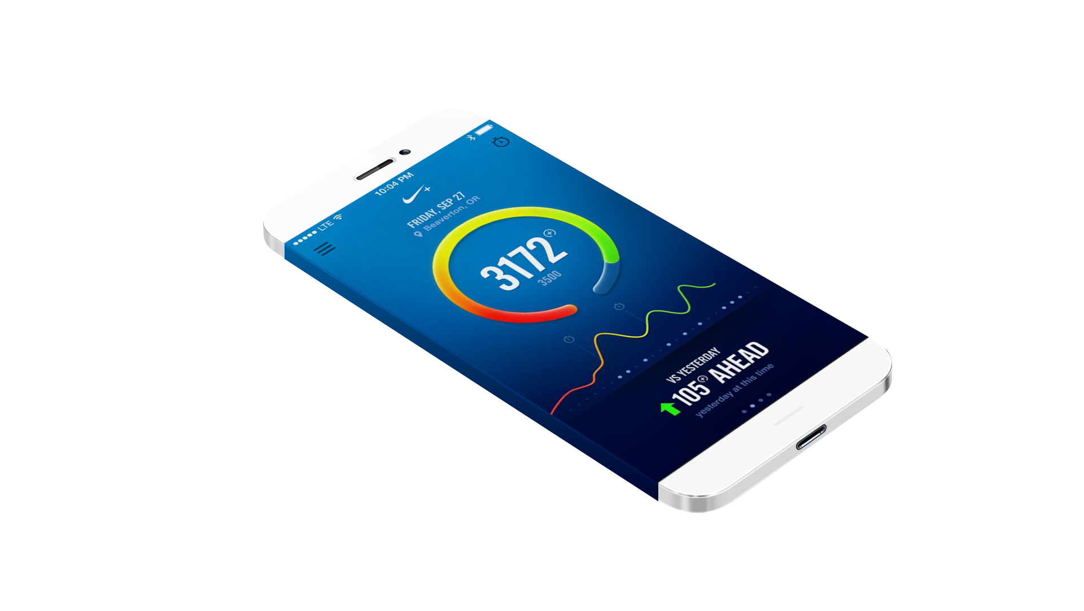






28M+ members
unique and valuable services
60% increase in revenue
Profits up 57%
Doubling their market cap
Nike
Notes:
Main Point
Validate using Nike case study
Script
Walgreens success was about discovering digital value. But we’ve also worked with companies like Nike who’ve used the digital opportunity to become even more relevant to their customers.
Over the last decade, Nike has added to their athletic gear business by extending the digital channel to offer unique and valuable services to the everyday athlete. They aim to go from “creating a better show to a better you.” In 2013, they were named the most innovative company in the world.
Just look at how they’ve used the Fuelband hardware and the Nike+ Fuel Labs. With numerous partner apps and a running community of over 28M members, they’ve been able to use Nike+ to fuel growth, driving revenue up 60%, profits up 57%, and doubling their market cap.
In fact, they have been so successful that they realized that the digital ecosystem was more valuable than the revenue from the Fuelband and have discontinued it in favor of expanding their ecosystem to incorporate other fitness devices
This is a truly dynamic and evolving ecosystem—and it runs on Apigee.

Slide 13





pull up plans
25+ apps in production to solve information distribution problem
save time and resources
Millions of dollars in cost savings
Bechtel
Notes:
Main Point
Validate B2E use with Bechtel
Script
We’ve seen what a difference these solutions can make.
Take Bechtel, the largest US construction and engineering company. They found that they faced major challenges getting accurate information and capabilities to workers out in the field. Their employees had the devices, but no easy way to get the functionality they needed to do their jobs outside the office—a major requirement when you work construction.
Bechtel used Apigee’s platform to put APIs at the center of their strategy to solve this challenge. Today, they have more than 25 apps in production to solve their information distribution problem. These apps make it possible for workers to save valuable time and resources in relatively simple ways like pulling up plans when they’re out in the field.
As a result of this strategy, Bechtel has already realized millions of dollars in cost savings on a few dozen construction projects.

Slide 14
API Management Platform
API Lifecycle Management
Developer Portal
Analytics
Monetization
Define
Develop
Publish
Support
Retire`
API Lifecycle

Slide 15



Internal API
Partner API
Open API
INTEGRATION
COLLABORATION
INNOVATION
API

Slide 16

*
API Management
Predictive Analytics
Internet of Things
Intelligent API Platform
Intelligent API Platform
Apigee 127
developer productivity
predictive analytics
Internet of Things
security
*Beta

Slide 17
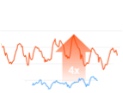
Apigee Edge: API-first - Built for APIs, Built with APIs
Self-Service
Alerting and Monitoring
Authentication
and authorization
Mission Critical Scaling
Flexible Deployment
19 Data centers
7 Geographical locations
Developer Portals
Management UI
SDKs
Apigee Edge APIs
Gateway API
BaaS API
Analytics API
Gateway API
BaaS API
Analytics API
Policies
BaaS Engine
Analytics Engine
Proxies
Collections
Trends
Node.js
Graphs
API Usage
Connectors
Notifications
Customization
App Users
Highly Available “NoSQL” Data
Scalable Time-Series Data
Billing API
Monetization Engine
Notes:
Main Point
Apigee Edge is API-first itself – built with APIs and built to manage APIs.
Script
As leaders in the API space, we have taken an API-first approach to Apigee Edge. Everything we put out as a product has an API. All of the components of the product are exposed as APIs.
That’s what enables us to provide developers with a self-serve platform and the flexibility to configure or code on our platform; that’s what enables our customers to customize the developer portal they offer to on-board their developers; and that’s what enables both out-of-the-box analytics reports as well as customizable reports for operational and business monitoring.

Slide 18
Complete and unified across the entire API lifecycle
Design Design first. Document Smart. Full support for Swagger 2.0
Monetize
Flexible rate plans
Internationalization support
Usage tracking
Limits and notifications
Develop
Configuration: Over 30 ready-to-use & configurable policies
Code: Built-in support for Node, JavaScript and
Java extensibility
BaaS
Analyze
Complete visibility– from app end to backend
Automatically and continuously collect all API-traffic data out of the box
Secure
End-to-end security
Threat protection
Access control
Simple OAuth implementation for your APIs
PCI and HIPAA compliance
Monitor Centralized control, decentralized development
Multi-tenant architecture
Billions of API calls, including large spikes
Publish
Turnkey developer portal
Scale
Self-service
State @ scale
Flexible deployment
Notes:
Main Point
Apigee Edge addresses your needs across the entire API lifecycle
Script
Apigee Edge addresses your needs across the entire API lifecycle – from designing APIs to building them to scaling your API program and finally monetizing your APIs. Apigee Edge satisfies a number of your needs that would otherwise be very time consuming and costly to build and operate at scale.
Let me show you how Apigee Edge supports you throughout the API lifecycle. Apigee Edge offers a very broad product footprint – we won’t have time to cover all the needs, however, we’ll cover a few salient ones.

Slide 19

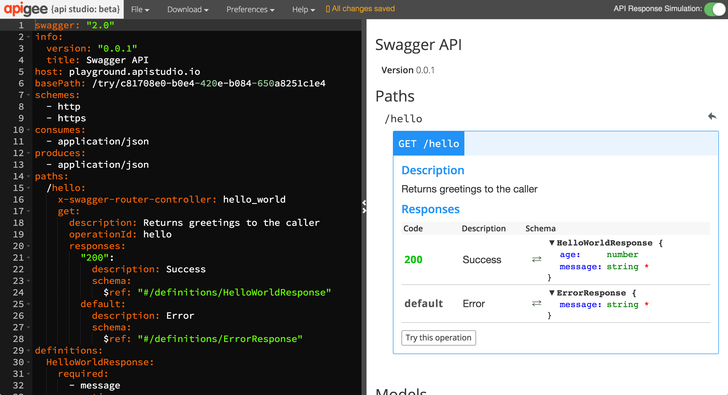
Build more consumable APIs
Design first. Document Smart. Full support for Swagger 2.0
Notes:
Main Point
Apigee Edge enables you to build more consumable APIs with a design-first approach
Script (needs to be verified)
APIs are built for app developers to consume. Its imperative that your APIs are useful to them – built in a way that makes their apps shine. If you build your APIs in a vacuum, you risk delivering APIs that don’t meet their requirements, which can result in costly and frustrating rework, and lengthy, unnecessary delays in getting your apps to market. Instead, Apigee Edge enables you to take a top down approach. You can design the APIs using Swagger and collaborate with your app developers to agree on a shape that works. You can use Smart Docs to build documentation for this API design. With this agreement in place, you can build the API knowing that they will be used. And While you’re building the API, your app developers can use mocks of the API designed and the smart docs to build their apps. With this agile approach, you increase your chances of delivering APIs and apps that make an impact, perform as expected; and deliver them FAST.
Link to Wiki
No differentiator page on Wiki
For Instance
None

Slide 20
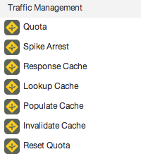
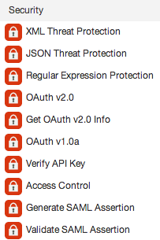
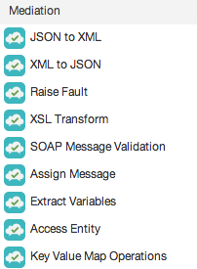
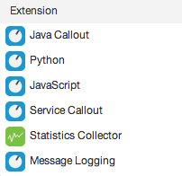
Build APIs faster
Manage interactions with API consumers and optimize performance
Secure APIs and protect back-end systems from attack
Transform, translate and reformat data for easy consumption
Extend with programming when you need it
Config - Over 30 ready-to-use and configurable policies Code - Built-in support for Node, JavaScript and Java extensibility
Notes:
Main Point
Apigee Edge includes over 30 easy to configurable policies and built in support for Node, JavaScript and Java extensibility
Script
Apigee Edge includes over 30 easy to configurable policies AND built in support for Node, JavaScript and Java extensibility
APIs developed with Edge can leverage the out-of-the-box, configurable policies, custom code written in JavaScript (Node.js) or Java, or both. The flexibility to leverage standard implementations, configuration AND code improves developer productivity by accelerating the time to solve both common and complex problems.
Common themes and use cases, are best handled with standard implementations and configuration. Apigee Edge provides Traffic Management, Security, Mediation and other policies out of the box that you can leverage, configure, and reuse across projects. These policies provide common, consistent, scalable, tuned implementations of common functionality.
Complex problems are best handled via software development, or a combination of configuration and development. Apigee Edge enables you to solve these complex or unique needs through extension polices. You can write these extension policies in JavaScript, Java, node.js, or external services.
In addition, with our micro-services architecture, you can implement a set small, independent, decoupled, focused processes with node.js and deploy them in the gateway to meet your unique needs.
Whether your needs are simple or complex, Apigee Edge provides you the flexibility you need to build APIs faster.
Link to Wiki
https://apigeesc.atlassian.net/wiki/display/SEP/API+Development+with+Configuration+and+Code
For Instance
None

Slide 21

Secure all points of engagement
Users
Connected Experience
Developers
APIs
API Team
Back-end
OAuth2
MFA
Federated Login
IP Access Control
API key
OAuth2
Mutual TLS
Access Block
Revoke
SSO
RBAC
OAuth2
Quotas
Spike Arrest
Threat Protection
Intrusion Detection
Bot Detection
RBAC
AD / LDAP
Audit
Mutual TLS
IP Access Control
Southbound VPN
End-to-end security PCI and HIPAA compliance
Notes:
Main Point
Apigee secures all points of engagement from user interactions to back end systems
Script
Security breaches are becoming increasingly common leading to brand damage, IP exposure, and costly mitigation procedures. Consumer expectations on security and privacy of PII data have increased dramatically.
Apigee Edge provides easy to use security features for each step of the value chain. In addition, the out of the box security features embody best practices and guidelines required by PCI and HIPAA regulations. With many security capabilities - Oauth 2 to secure user and app interactions, many easy to configure and extend self-service policies and features to mitigate threats to your APIs. e.g. Rate limiting policy to protect any traffic spikes due to DoS attacks, role based access control, Mutual TLS and more – Apigee secures all points of engagement from user interactions to the back end.
Apigee Edge is (penetration) pen-tested by a 3rd party vendor. This means our private cloud customers can deploy it without further security testing required. We can provide a pen-testing report to your internal security and audit team – this not only accelerates the time to deployment but it can also save you $25-50K of pen testing cost.
Cloud customers can rely on Apigee’s expertise and experience in hosting thousands of customer APIs in our cloud and resolving any emerging security vulnerabilities. We respond to security patches in days and release it so you don’t have to worry about new security vulnerabilities.
Apigee brings years of infrastructure and service delivery partner strength such as strategic partnership with AWS. For example we have mitigated risks to customers due to security vulnerabilities such as - FREAK, HEARTBLEED, SHELLSHOCK, POODLE. All responded within 24 hours with least impact to our customer APIs and availability. We're part of AWS Advisory Council to influence their strategic direction and security features. We have a strong architecture and AWS partnership (people, process, tech) to address DDoS on Apigee cloud.
Link to Wiki
https://apigeesc.atlassian.net/wiki/display/SEP/THEME+%3A+Security (see each section under this theme)
For Instance
Apigee Edge software is trusted by hundreds of customers in Health care, Financial and Govt vertical to protect their APIs and meet their PCI, HIPAA and other compliance needs.
Retail customers including Target, Home Depot, Kohls - Financial customers like Vantiv, Firstdata, Amex; Healthcare customers like Humana, Cambia Health, HCSC and various Govt customers.
When Heartbleed, FREAK, was discovered, we were able to mitigate the vulnerability within 24 hours with no visible impact to our customer API traffic
When AWS had a hypervisor vulnerability that required 50% of Apigee servers to be rebooted automatically without notification, we were able to sustain the reboots with zero downtime.
SAP does security pen-testing on every Apigee release and we have always passed their stringent benchmark for OWASP Top 10 and SANS 25 application security standard.

Slide 22
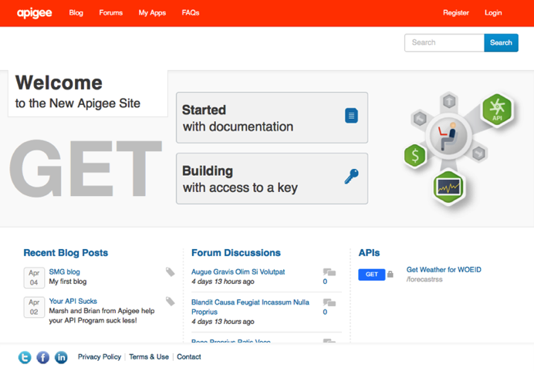
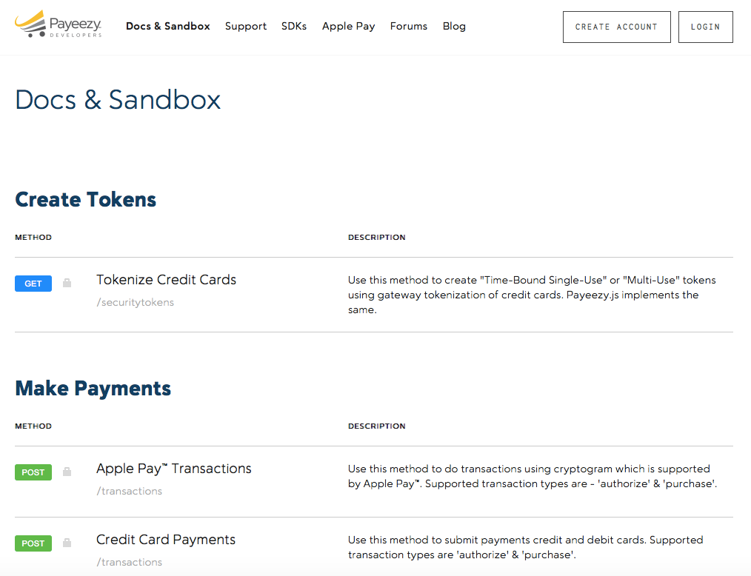
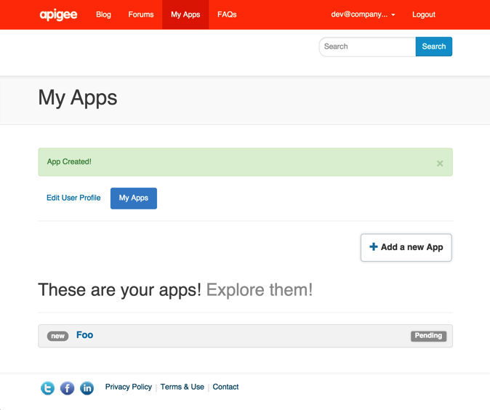
Make it easy for developers to use your APIs
“Reduced time to first app from
4 weeks to 6 hours.”
- Online Education Provider
Automatic or manual registration
Self-service app key requests
Self-documenting
Turnkey developer portal
Notes:
Main Point
Make it easy for developers to use your APIs with a secure and turnkey developer portal that gives them self-service access to your APIs, forums, blogs, sandbox, analytics, and more.
Script
Make it easy for developers to use your APIs with a secure and turnkey developer portal that gives them self-service access to your APIs, forums, blogs, sandbox, analytics, and more.
With Apigee Edge, you can deploy a custom and turnkey developer portal that provides self-service access to your APIs, api-keys, and SmartDocs. The developer portal comes with hundreds of pre-installed modules such as polls, blogs, and forums; external authorization for login, such as Google, GitHub, LDAP, and OpenId; Internationalization; Issue tracker integrations like BugHerd; Google Analytics; and more. In addition, with over 10,000 open source Drupal modules and themes available, covering a huge range of use cases, you can install and configure new add-ons to get the desired functionality, such as Jira integration, powerful workflow tools, content rating tools, and much, much more. Additionally, the developer portal is based on open source Drupal technology with a 1M+ developer community. This enables you to customize Drupal to meet your unique needs and easily find developers to augment your internal teams.
As developers participate in your API program, the analytics within Apigee Edge enable you to measure usage, adoption and engagement so you can tailor your APIs and program appropriately to meet their needs.
Leading enterprises such as First Data, Walgreens, Pearson, Equinix and many more are using the Developer Portal to make it easy for their developers to use their APIs.
Link to Wiki
https://apigeesc.atlassian.net/wiki/pages/viewpage.action?pageId=76415368
For Instance
Walgreens - launched their portal with minimal customizations on top of the out of the box portal. But on the other hand, ATT used Edge’s management APIs to build their own developer portal from scratch.
Equinix -https://developer.equinix.com/ - partner and internal . Onboard their users using an internal system and then the developers get access to dev portal via sso.
Gracenote - https://developer.gracenote.com and https://developer.ntt.com/en portals are available in both Japanese and English. They leverage the OOB i18n features.
Pearson - community.pdn.pearson.com a complete custom module built into http://developer.pearson.com/ . A nice custom built app gallery http://developer.pearson.com/product-showcase with capabilities like “Related Showcases” etc. done with Drupal’s powerful taxonomy feature. Custom feature like Bookmarks for contents.
First Data in their portal has different flows for customer on boarding and merchant on boarding. They have also built a custom flow for Certifying the apps which are getting registered in their dev portal.
Whatever flow you want to have for authentication :
EE - user is registered only by their support in their own support portal and then the details sent to the user
Gracenote - Enabled social login on their dev portal. Developers can choose to Login via facebook at the registration page.
First Data - included security questions as part of registration
Associated Press/Pitney Bowes wants to include their internal customer IDs generated from different systems while customer registers. Registration flow customized to make a call to their internal systems to generate/retrieve customer IDs to include in custom attributes of developer.
Vantiv - App certification process : Vantiv uses a App certification process to qualify and graduate developers from a sandbox environment to production. Today, it is a manual and high touch process. Vantiv wanted to move to a more self service model and therefore automate the app certification process. The new model is that the developers takes tests which are logged, and when they pass the test, they automatically are approved to move their apps to production. The extensibility of our developer portal in addition to the inbuilt rules engine allowed us to build this custom workflow out resulting in a highly self service workflows that the customer finds extremely helpful.

Slide 23
Gain visibility into the entire digital value chain
Relevant, Actionable and Extensible Dashboards, Tools & Custom Reports
User
App Analytics
Developer Analytics
API Analytics
Backend
App Performance
App Usage
API Performance
Filter by app version, device, platform, OS, etc.
Top Developers
Developer Engagement
Top API Users
Top Products
Top Apps
API Traffic Patterns
API Performance
Geo location
Anomalies
Multiple metrics – traffic, response times, errors, data exchange, etc.
Complete visibility– from app end to backend
Automatically and continuously collect all data about your API traffic out of the box
Notes:
Main Point
Apigee Edge provides complete visibility into the entire digital value chain – from app end to the back end
Script
The digital value chain stretches all the way from the user to the back end services. Digital requires you to know how you’re doing at every stage of the value chain. Apigee Edge provides complete visibility into the entire digital value chain – from the app end to the back end.
Apigee Edge automatically and continuously collects analytics data from all API traffic. As a result, you do not need separate tools for API analytics, saving you costs in terms of resources, infrastructure and on-going maintenance. Since the data collection is continuous, you can see meaningful API trends and API failures that may not be apparent when analytics are measured at coarse aggregation intervals. In fact, Apigee Support uses the same analytics data to help resolve customer issues.
Apigee Edge provides complete visibility into the health and performance of your APIs. Apigee Edge provides a number of out of the box charts that help you measure and monitor traffic, performance, latency, errors and more. The out of the box charts also reduce downtime – you can quickly identify potential bottlenecks with target endpoints based on the observed API performance and usage trends. Using this information, you can make changes to their target endpoints and avoid potential downtime.
Apigee Edge enables you to improve the productivity of your developers consuming your APIs by using the OOTB charts to identify issues related to latencies or errors, and proactively reaching out to those developers to help them properly consume APIs. This results in consuming developers fixing their apps quickly with the help of the API team rather than doing it on their own.
Apigee Edge provides complete flexibility with self-service custom reports. You can quickly adapt to changing business and customer needs by extending the core analytics to capture additional data from your APIs and create powerful custom analytics reports using the self-service interface. Edge Analytics allows you to create custom metrics and dimensions and use them in any report, custom report or analytics API. You can use virtually any attribute that describes traffic to create custom metrics and dimensions. This means you can use more than 500 variables available in the gateway, or extract them from the API request, response, request payload or response payload. You can use these custom variables in default reports such as Investigate Anomalies or in Custom Reports
While Apigee Edge collects a lot of API data, we recognize that you often also have a need to combine this data with other operational and business data obtained by other means. Apigee Edge enables you to create custom queries against raw traffic data using RESTful APIs. You have full flexibility to obtain Apigee collected metrics using automated scripts as-and-when needed. Without this capability, you would need to understand the underlying data schema, use database specific SQL scripts, etc. to obtain the raw traffic data that you need. As a result of these Analytics Apis, you can reduce data extraction costs and easily integrate with existing reporting, analytics, and visualization tools. This reduces the time, effort, and costs of making Apigee Edge to work with existing enterprise tools and initiatives.
In addition, Apigee Edge provides analytics for your mobile developers enabling them to monitor the usage, performance, and crashes and errors in their mobile apps.
This end to end approach provides unprecedented information about how your entire value chain is interacting with your services.
Link to Wiki
https://apigeesc.atlassian.net/wiki/display/SEP/Out-of-the-Box+Charts+for+API+Performance+and+Usage
https://apigeesc.atlassian.net/wiki/display/SEP/Automatic+Continuous+Data+Collection+from+all+API+Traffic
https://apigeesc.atlassian.net/wiki/pages/viewpage.action?pageId=76415356
https://apigeesc.atlassian.net/wiki/display/SEP/Apigee+APIs+to+Create+Custom+Queries+Against+Raw+Traffic+Data
For Instance
A customer had a 7 minute outage and didn't even know about that outage from the analytics reports because the data they collected was done done at a coarser granularity and aggregated. Using Apigee Edge, we would have known about the outage based on the continuous analytics that are collected, which would have shown up in the out-of-the-box dashboards. The customer may be having multiple outages like this without their knowledge, which may result in customer satisfaction going down and may even impact revenue.
Another data point is Apigee’s own usage of these API analytics in supporting our Cloud customers. Using this capability, Apigee was able to collect metrics on over 100B+ API calls that happened in 2014 - the Apigee Support team did not have to do anything to collect these metrics, but found this analytics data to be very valuable in resolving customer issues.
Large retailer encountered a situation where users of their mobile app had to re-login frequently. This was a result of an inadvertent change to the TTL of the refresh token from 60 days to 2 hours. Using the Analytics APIs, the customer and Apigee GSC were able to run queries that helped them get Refresh Token TTL information given respective Access Token IDs and identify this misconfiguration.
First Data uses Analytics APIs to measure the total revenues driven by each retailer partner that's using their Payeezy APIs for Apple Pay. Immediately following the launch of Apple Pay, First Data was able to measure the success of the Apple Pay program across various retailers by capturing the transaction amounts from the API message payload and generating analytics reports in Apigee without any custom development.
After launching their APIs for developers, Sony Mobile wanted to measure the success of their API program by tracking daily growth in adoption of their APIs by developers and apps. They used the Analytics APIs to run their queries from a Node.js application that collects traffic data for each API, developer, and app from the launch of those APIs to measure the overall growth and individually by each developer and app. This data is compiled and reported up to their executives on a daily basis.

Slide 24


Monetize APIs: Any partner, any business model
Revenue-sharing models (API provider charges developer)
Fee-based models (API provider charges developer)
Freemium models
Fixed
Transaction
Duration
Flexible
Transaction Volume
Quantity
Hybrid (flat fee plus fixed and flexible)
Custom Attribute
Hybrid
Revenue / Volume Bands
One-time
Subscription
Advance / Arrears
Pro-rated / Full amount
Flexible rate plans, internationalization support, usage tracking, limits and notifications
Notes:
Main Point
Apigee Monetization provides end-to-end self-service capabilities to create, publish, and access a variety of rate plans and other configurations.
Script
To build a digital business, you need a way to monetize your APIs. You need support for many different business models and you need to monetize without without going through expensive and disruptive changes to back systems to meet business needs.
Apigee Monetization provides end-to-end self-service capabilities to create, publish, and access a variety of rate plans and other configuration. API product managers / business users can independently package, price & publish API products & packages. There is little to no dependence on IT to roll out these API plans. For instance, A travel/hospitality service provide will be able to quickly create revenue share, freemium and many innovative pricing models to experiment on what works best for their partners. They don’t have to waste time & money on changing their financial systems to try out new pricing models.
Apigee provides a breath of out-of-the-box pricing models that you can use to create variety of rate plans. Finding the most effective API monetization model is often iterative. To support an agile approach, Apigee Monetization supports iterative experimentation, enabling you to succeed fast or fail fast without requiring the costly investments and extensive changes to existing systems that traditional approaches will require. For instance, A major European telecom provider is designing new business models and using Apigee’s monetization features to introduce a new messaging product (SKU) into their offerings. Typically, introducing a new product into a financial System of record for the provider takes 6-12 months. With Apigee's monetization capabilities, the provider will be able to implement their plans in a fraction of the time.
Apigee monetization supports multiple currencies, end-to-end billing and export usage reports to sync. with existing financial/accounting systems. With Apigee Monetization, you do not have to waste cycles on custom integrations to connect usage & billing across your disparate backend offices globally and sync currencies across disparate systems. For example, a leading business profile data provider (Dunn & Bradstreet) is using Monetization to track usage & billing for their partners. Our solution will simplify billing complexities due to multiple currencies and disparate backend financial systems.
Finally, Apigee Monetization enables you to proactively track usage and use limits, and notify your partners on their usage and plans. By notifying customers and partners before they accrue huge overages enables you to avoid unnecessary billing disputes and the resulting dissatisfaction and revenue loss. In addition, tracking partner usage patterns enables you to identify any upsell opportunities or suggest a better plan. For instance, a leading travel / hospitality service provider sets limits of use and manage notifications for expirations, renewals and overages
Link to Wiki
https://apigeesc.atlassian.net/wiki/display/SEP/FEATURE+%3A+Monetization (see features within this area)
For Instance
A travel/hospitality service provider will be able to service market opportunities with limited to no-touch from the enterprise sales team. Additionally, they will be able to provide an automated workflow for the purchase of plans, bills receipts and notifications.
A Telco/Service Provider mentioned that what would typically take a 6-12 month effort can be accomplished in fraction of the time with Apigee's monetization features. This speaks to the products capabilities to provide faster time-to-market and quickly capitalizing on market opportunities.
A travel/hospitality service provide will be able to quickly create revenue share, freemium and many innovative pricing models to experiment on what works best for their partners. They don’t have to waste time & money on changing their financial systems to try out new pricing models.
A major European telecom provider is designing new business models and using Apigee’s monetization features to introduce a new messaging product (SKU) into their offerings. Typically, introducing a new product into a financial System of record for the provider takes 6-12 months. With Apigee's monetization capabilities, the provider will be able to implement their plans in a fraction of the time.
Leading business profile data provider (Dunn & Bradstreet) is using Monetization to track usage & billing for their partners. Our solution will simplify billing complexities due to multiple currencies and disparate backend financial systems.
A leading travel / hospitality service provider sets limits of use and manage notifications for expirations, renewals and overages
Key Points to Reiterate
Monetization enables you to truly treat your APIs as products and build a business around them
Flexibility to support wide variety of business models, rate plans, multiple currencies, as well as end to end billing and enables you to export usage reports to sync with existing financial / accounting systems.
With Apigee Monetization, you don’t have to adapt your business to match the technology – we can support virtually any business model. And you do not have to waste cycles on custom integrations to connect usage & billing across your disparate backend offices globally and sync currencies across disparate systems
Enables you to “fail fast” or “succeed fast”

Slide 25

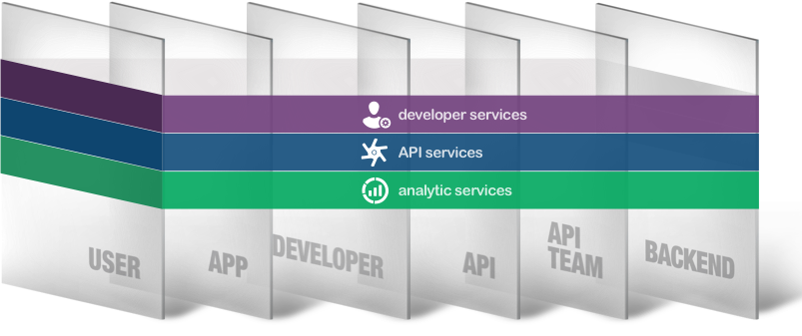
Apigee Edge
Value Proposition
Apigee offers API management software that dramatically accelerates the transformation of any company into a digital business by reducing the time and cost of creating engaging, innovative digital experiences
Unified, integrated platform for API exposure, discovery, consumption, and operations management
Transforms web services into manageable, elegant APIs
Enables developers to self-discover and test APIs
Protects systems from internet-based threats through rate limiting, authentication, and authorization policies
Provides visibility of digital interactions from backend to app
Notes:
Remainder of my time, one of my products, Edge
This discussion will underscore

Slide 26
?

